Slide 1
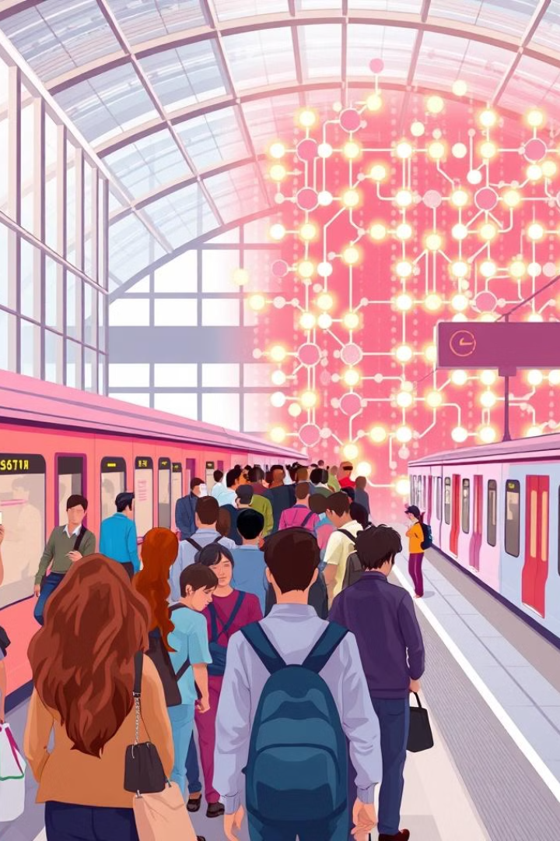
Railway Reservation System: A Binary Search Tree Approach
This presentation will explore how a Railway Reservation System can be efficiently implemented using a Binary Search Tree (BST) data structure. We will delve into the advantages of this approach and showcase the key features of the system.
Submitted By:-
Ketan Bhaskar(2245978)
Kunal Kumar(2245927)
Jitu Kumar(2246255)
Hasan Raja(2246126)
Submitted to:-
Mrs. Deepti Bansal Ma’am

Slide 2


Objectives of the Presentation
1
Efficient Ticket Booking and Reservation
2
Scalable System Design
Explain how the BST-based system can handle increasing user demands and data volumes.
Demonstrate how a BST can optimize the ticket booking and reservation process.
3
Enhanced User Experience
Highlight the user-friendly features and benefits of the Railway Reservation System.

Slide 3
About Binary Search Trees
Key Characteristics
Ordered Structure
Time Complexity
BSTs are self-balancing data structures that allow for efficient searching, insertion, and deletion of elements.
The elements in a BST are arranged in a specific order, with the left subtree containing values less than the root, and the right subtree containing values greater than the root.
Basic operations in a BST have an average time complexity of O(log n), making them highly efficient for large datasets.

Slide 4
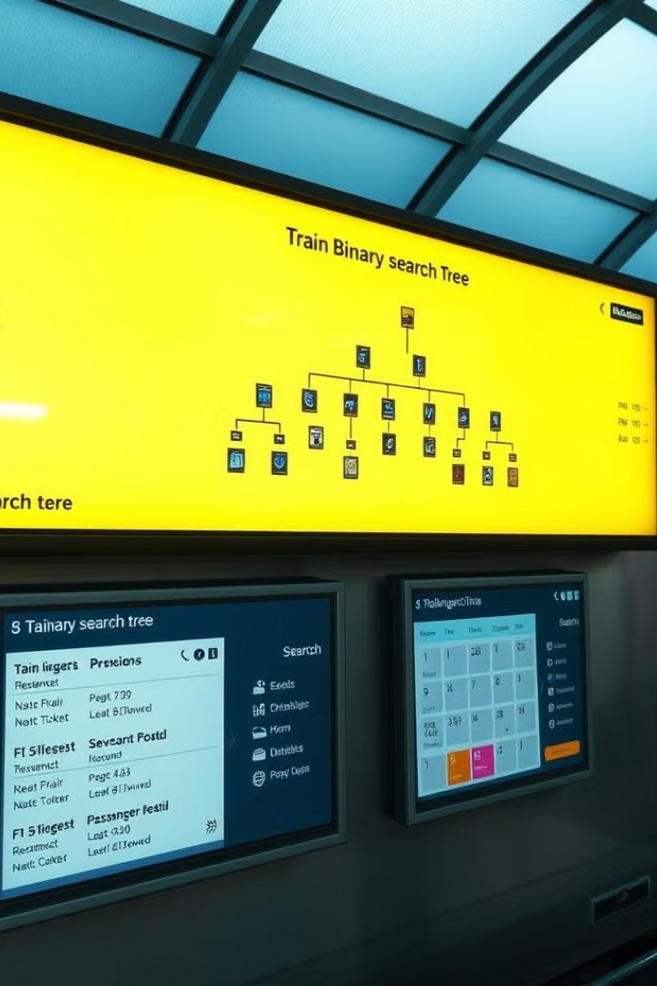
Implementing Railway Reservation using BST
1
Train Schedule
The BST stores train schedules, routes, and availability, allowing for efficient search and retrieval.
2
Passenger Booking
Users can book tickets by searching for desired trains and adding their reservation details to the BST.
3
Reservation Management
The BST-based system can handle seat availability, cancellations, and modifications to bookings efficiently.

Slide 5
Programming Language and Compiler
Compilers
C
"The code is compiled using industry-standard C compilers, such as GCC or Clang, ensuring optimal performance, reliability, and compliance with ANSI C standards
The Railway Reservation System is implemented using the C programming language, known for its efficiency and performance.

Slide 6
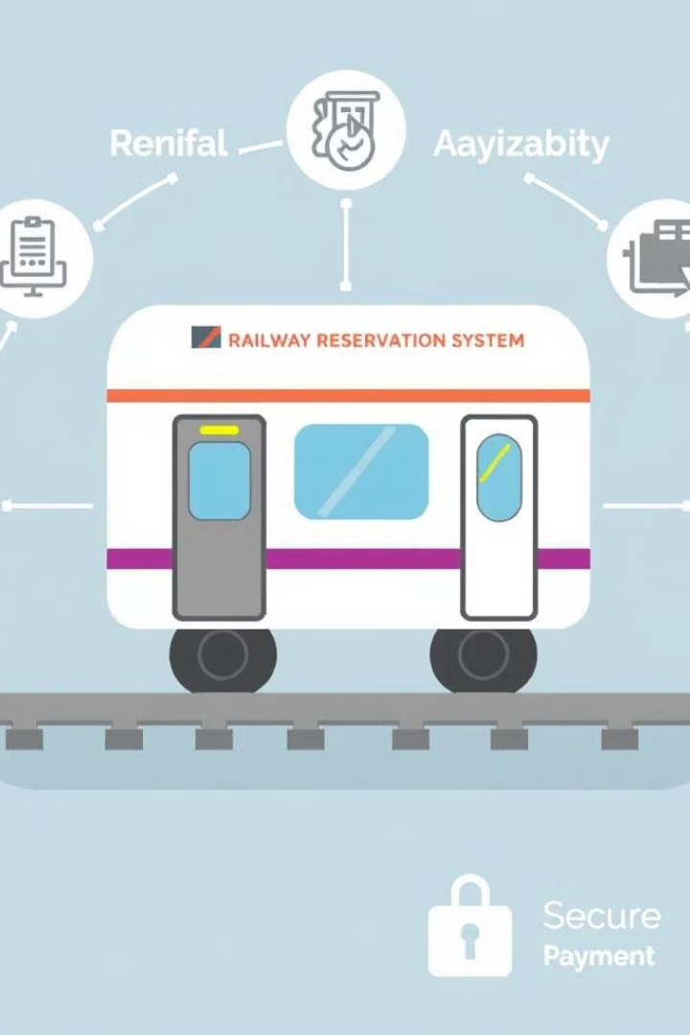
Key Features of the Railway Reservation System
Real-time Availability
Flexible Booking
The system provides up-to-date information on train schedules, seat availability, and reservation status.
Users can easily search, book, modify, and cancel reservations through a user-friendly interface.
Secure Payment
Scalable Architecture
The system integrates with secure payment gateways to ensure seamless and reliable financial transactions.
The BST-based design allows the system to scale efficiently to handle increasing user demands and data volumes.

Slide 7
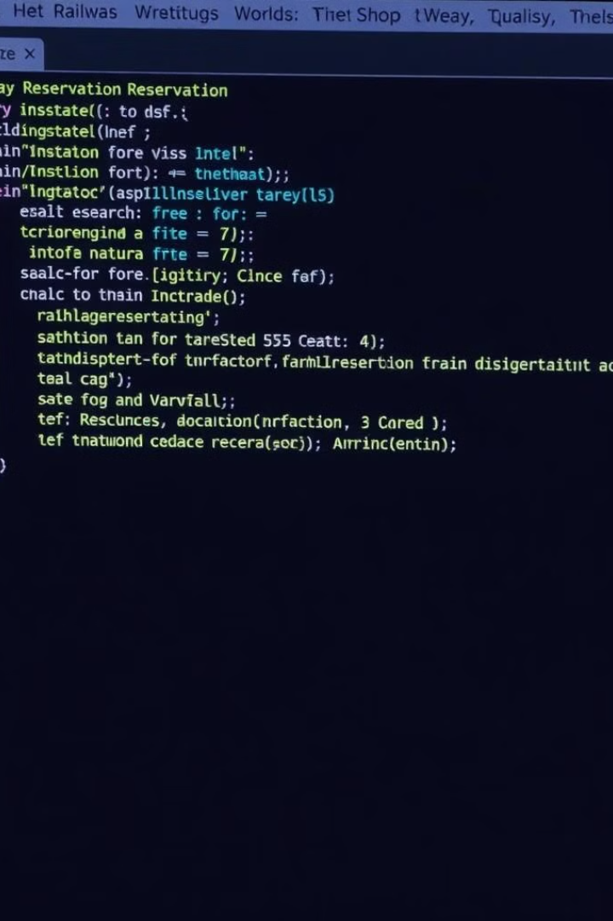



Code Walkthrough
BST Implementation
The core of the system is the binary search tree data structure, which stores and manages train schedules and reservations.
Reservation Operations
The code includes functions for searching, booking, modifying, and cancelling reservations using the BST.
User Interface
The system provides a user-friendly interface for customers to interact with the railway reservation functionality.

Slide 8
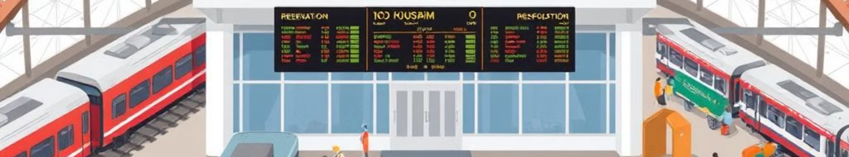




Industrial Applications of the System
Railway
Bus Transport
Air Travel
Logistics Management
The BST-based system can be applied to railway reservation systems, managing schedules, availability, and bookings.
The same principles can be extended to manage bus reservations and schedules using the BST structure.
The scalable and efficient BST approach can also be adapted for airline reservation and ticketing systems.
The system can be further expanded to handle cargo and logistics management for various transportation modes.

Slide 9
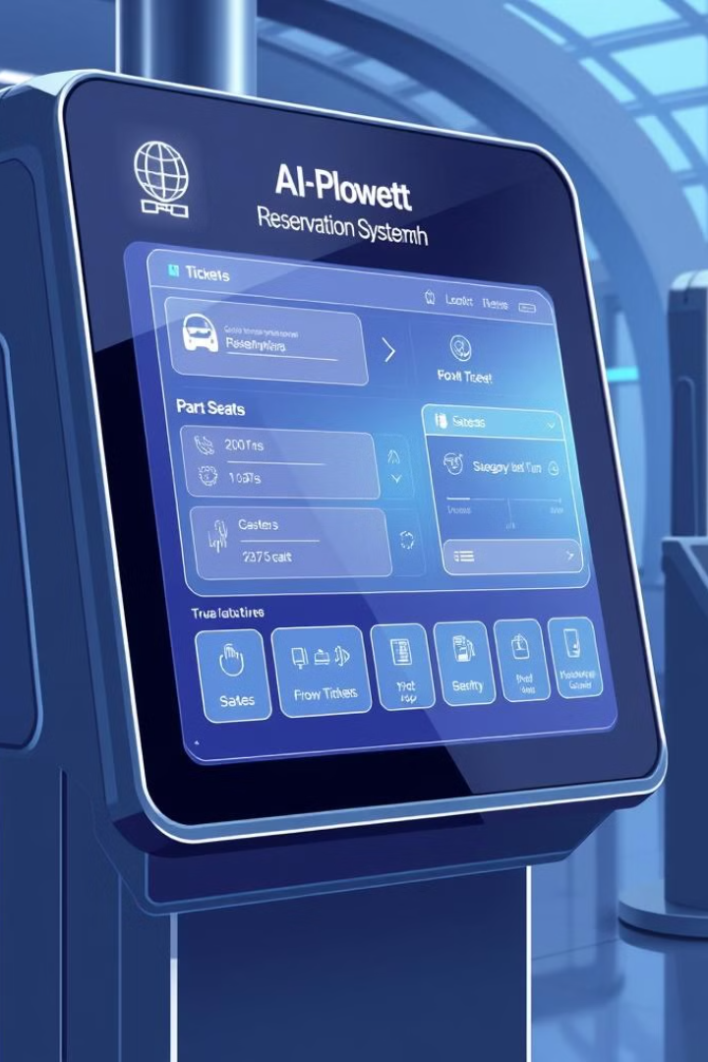
Future Enhancements and Possibilities
1
AI-powered Recommendations
Integrating machine learning algorithms to provide personalized travel suggestions and optimize routing.
2
Mobile App Integration
Developing a comprehensive mobile app for seamless reservation management and real-time updates.
3
Multimodal Integration
Connecting the railway reservation system with other transportation modes for a unified travel experience.

Slide 10

Conclusion and Key Takeaways
1
Efficient Ticket Booking
2
Scalable Architecture
The BST-based approach optimizes the railway reservation process with fast search and booking capabilities.
The system's design can handle increasing user demands and data volumes through the BST structure.
3
Versatile Application
4
Future Enhancements
The principles demonstrated can be applied to various transportation modes, from railways to air travel.
Incorporating AI, mobile integration, and multimodal connectivity can further enhance the system's capabilities.

